Slide 1
Garage B Solution
Shailesh Kulkarni

Slide 2
HLD
Garage Cloud Solution
Inventory Service
Inventory DB
Load Balancer
Inventory Cache
Supplier A Order Adaptor Service
Supplier A Service
Garage Web Application
API Gateway
Kafka
Cloud Schedular
Order Cache
Load Balancer
Order Service
Order DB
Supplier B Order Adaptor Service
Supplier B Service

Slide 3
Solution Components
Garage Web Application
API Gateway
Inventory Service
Database for inventory data
Redis Cache for inventory data
Order Service
Database for inventory data
Redis Cache for inventory data
Supplier A Adaptor Service
Supplier B Adaptor Service
Kafka – For message bus
Cloud Scheduler – Invoking scheduled Lambda function

Slide 4
Services Details
Inventory Service
Exposes REST APIs for the Garage Web Application
REST API - HTTP PUT /items
Maintain its own database and cache to store Item details and its inventory details.
Processes Item inventory updates from end user from API calls and sends to ItemInventory Kafka topic to process request in async mode.
Poll ItemInventory Kafka topic and get the Inventory update request and check the items updated inventory value and if required sends order to ItemOrder kafka topic which will be processed by Order service.
Order Service
Maintain its own database and cache to store order details.
Order service polls the Order service kafka topic and get the orders for processing, persist order into its database.
If the order needs to be processed with local supplier then it sends order to SupplierA service’s topic for further processing.
Schedular lambda function at specific time (12 AM) sends message to OrderService Topic to process the International Orders in bulk between (12-1 AM).
International orders sent to Supplier B topic for further processing.

Slide 5
Services Details
Supplier A Adaptor Service
It understands Supplier A (Local) B2B application interface and places the order to Supplier A.
Polls for the Supplier A topic and gets the orders to be placed to Supplier A.
Supplier B Adaptor Service:
It understands Supplier B (International) B2B application interface and places the order to Supplier B.
Polls for the Supplier B topic and gets the orders to be placed to Supplier B.
Kafka:
Its backbone for asynchronous processing of item inventory updates, placing orders and can scale well in future.
API Gateway
Exposes APIs of Inventory service and rest of the services are not accessible from the outside and are in private VPN.

Slide 6
Main Idea
Inventory Service, Order Service they are de-coupled with the messaging infrastructure so that they can handle the back pressure and can scale well.
Garage to actual supplier order is business to business (B2B) transaction and different supplier have different interfaces for integration with their systems and getting events.
For Supplier A and B, separate adaptor service is created and de-coupled with Order service via messaging infrastructure for scaling and handling backpressure.

Slide 7
Database and Caching
Inventory service and Order service will have its own database and Redis cache.
Database isolation can help in scaling up of the databases for different services as per requirement as Order services data is likely to grow faster compared to Inventory items.
Redis caches are separate for these services so that it can scale up independently.

Slide 8
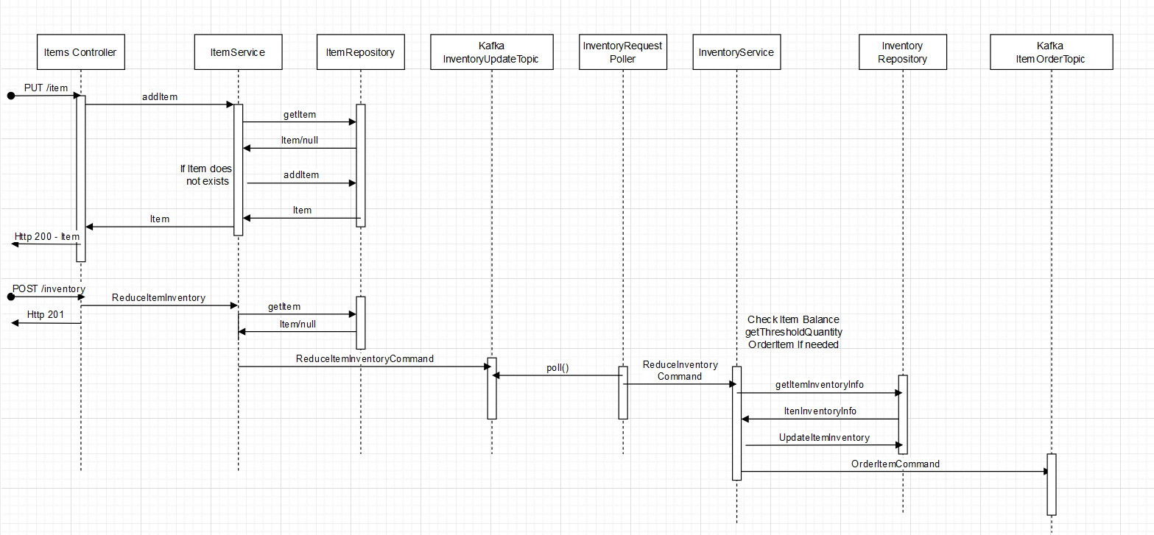
Items Service Sequence Diagram

Slide 9
Deployment Diagram
Garage Cloud Solution
Inventory RDS Postgres DB
Load Balancer
Inventory Service
Inventory Redis Cache
Supplier A Order Adaptor Service
Garage Web Application
API Gateway
Kafka
Cloud Schedular
Order Redis Cache
Supplier B Order Adaptor Service
Load Balancer
Order Service
Order RDS Postgres DB

